Slide 1
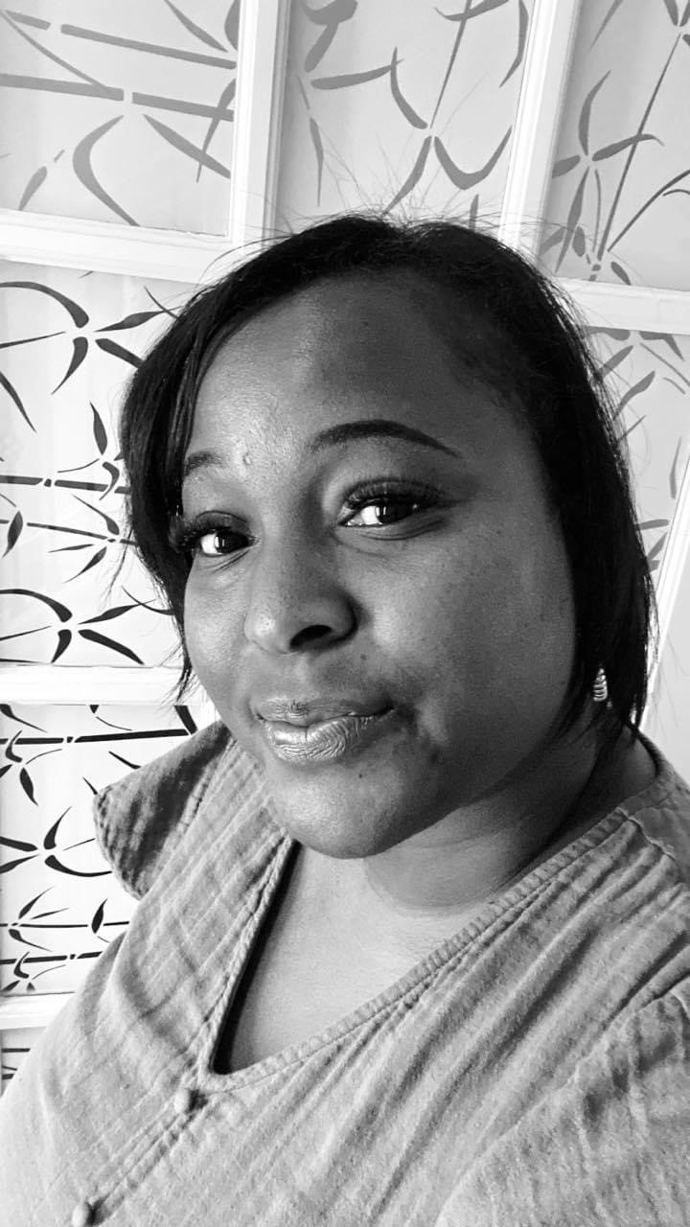
Editable Meet the Teacher Template (Color)
This is an EDITABLE version of the template used to create the sample letter. Customize this template for your class!
I’m Mrs. Fowler
This year awaits new adventures as we dive into Math, Reading, Science and Social Studies. It will inspire and be filled with love as I educate the whole child.
Color: Lavender
Book: The Bible
Candy: M&M’S with nuts, almond joy, and snickers.
Hobbies: Spending time with family and shopping.
I am married and we have a handsome eight year old son. Teaching is my passion and it is so rewarding to watch our future leaders.
ClassDojo
Email:fowlesh3@boe.richmond.k12.ga.us
Phone: (706)796-4985

